Slide 1
Social Determinants of Health
Angela Elam, MD
Ambar Faridi, MD
Kristen Nwanyanwu, MD, MBA, MHS
Sriranjani Padmanabhan, MD
Neeti Parikh, MD
Fasika Woreta, MD, MPH
* Authors and Contributors in Alphabetical Order

Slide 2
Pre-Quiz
What are social determinants of health (SDOH)?
Are you able to name a few SDOH?
Have you seen how SDOH have impacted patients in your clinic?

Slide 3
Objectives
Define social determinants of health, health disparity, and health equity.
Describe how SDOH impact ophthalmology.
Delineate personal experiences with patients and identify inequities.
Address your awareness of your biases that may help or hinder equitable patient care.
Identify resources and approaches that can enhance care with equity in mind – and implement these resources.
Notes:
Realms:
Economic ( Income, Insurance, Housing, Transportation, Food)
Identity (Immigration, Language, Racism, Health Literacy, Gender
Disability (Visual, Psychiatric, Physical Comorbidities that affect functional status)
Specific subspecialitieideally SFGH data extraction will highlight these
5) underutilized

Slide 4
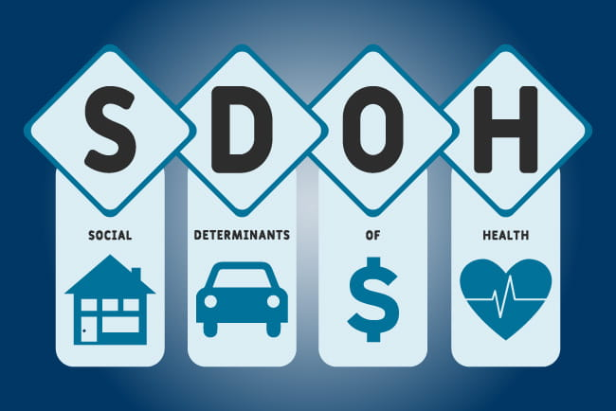
BCSC Update on General Medicine Chapter 17: SDOH
SDOH are conditions in the environment in which people are born and grow, live, learn, work, and age that affect health outcomes.
SDOH are major drivers of health disparities in medicine.
Ophthalmology is not an exception.

Slide 5
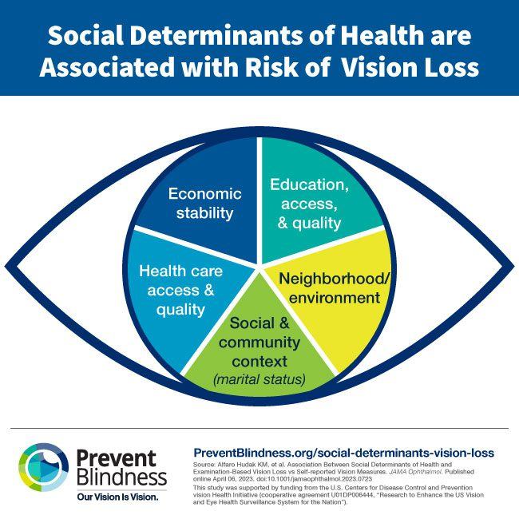
Health Disparity vs. Health Equity
A health disparity is a difference in health outcomes that arises from health inequities that affect medically underserved populations.
A health inequity is the unfair distribution of health determinants, outcomes, and resources between and within different segments of a population based on social, economic, environmental, and structural factors.
The goal of eliminating health disparities is to achieve health equity, which can be defined as a state in which every individual has a just and fair opportunity to achieve their best health (and vision).

Slide 7
How much do SDOH affect health outcomes? How much does medical care account for health outcomes?
SDOH is estimated to account for 80% of a population’s health outcomes, whereas medical care accounts for only 20%

Slide 8
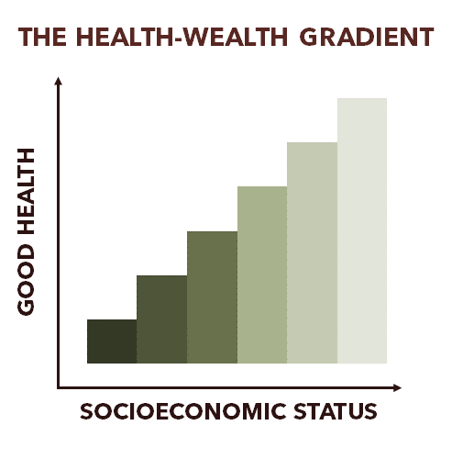
People with more income, education, and social standing tend to live longer, healthier lives.
Differences in these factors can have compounding and cyclical effects that accumulate over generations.
Source: sycamoreinstituteTN.org

Slide 9
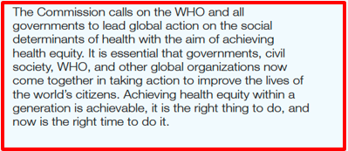

Slide 10
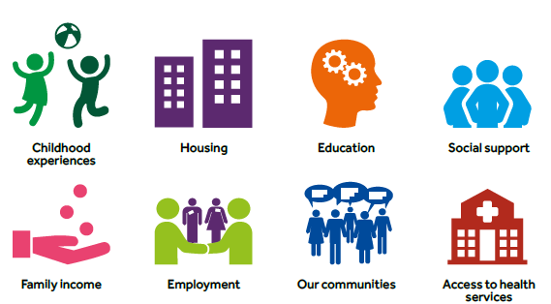
SDOH: Five Domains
Health care access and quality (eg, insurance, physician availability, communication)
Economic stability (eg, employment, income, housing and food security)
Education access and quality (eg, education, literacy, language skills)
Neighborhood and built environment (eg, transportation, safety, geography, pollution, parks)
Social and community context (eg, community engagement, social cohesion, incarceration rates)

Slide 11
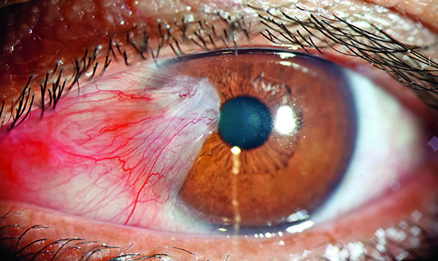
SDOH Impact in Ophthalmology
In the United States, underrepresentation in US status, lower educational attainment, lower income, and lack of insurance are all associated with greater visual impairment.
Ophthalmologists should assess the impact of SDOH as part of every patient encounter and should address SDOH in the treatment of patients.
Source: https://www.pointsdevue.com/

Slide 12
1. Health Care Access and Quality
What are the barriers to accessing health care and receiving high-quality care?
Inadequate health insurance coverage results in high out-of-pocket costs.
Rates paid by uninsured Americans have decreased under the Affordable Care Act, but ~10% of people in the US remain uninsured.
Vulnerable population groups, such as underrepresented and underprivileged groups, account for over half of the uninsured population.
Other barriers include poor access to transportation, limited health care resources and physician availability in underserved areas, and poor physician-patient communication.
Poor communication results from patient fear or lack of trust due to racism and discrimination in medicine, lack of time, cultural and language barriers, and lower literacy levels.

Slide 13
Ophthalmology Tie-In:

Slide 14
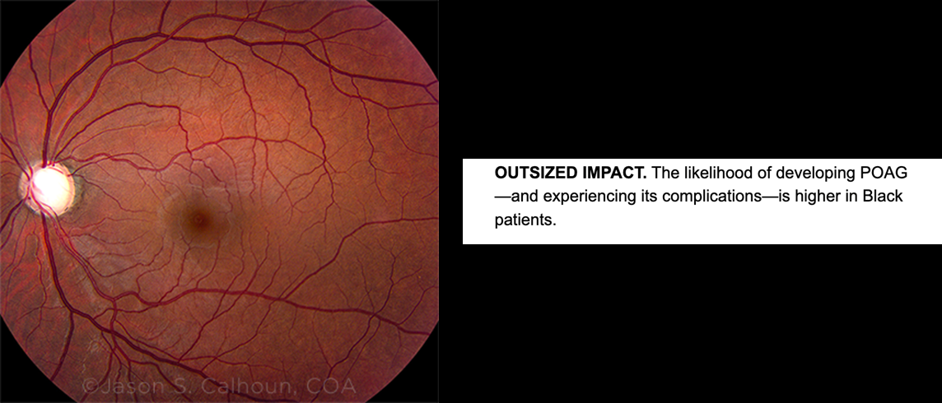
Ophthalmology Tie-In, Elam et al:
“Medicaid patients with a new diagnosis of POAG receive substantially less glaucoma testing in the 15 months following initial diagnosis compared with patients with commercial health insurance.
This disparity is most striking in Black patients with Medicaid insurance, who had 291% increased odds of not undergoing glaucoma testing, compared with Black patients with commercial health insurance.
Further, Black patients are more likely than White patients to go blind from POAG, highlighting the importance of efforts to improve the quality of glaucoma care for Medicaid recipients and ethnic minority groups.”

Slide 15
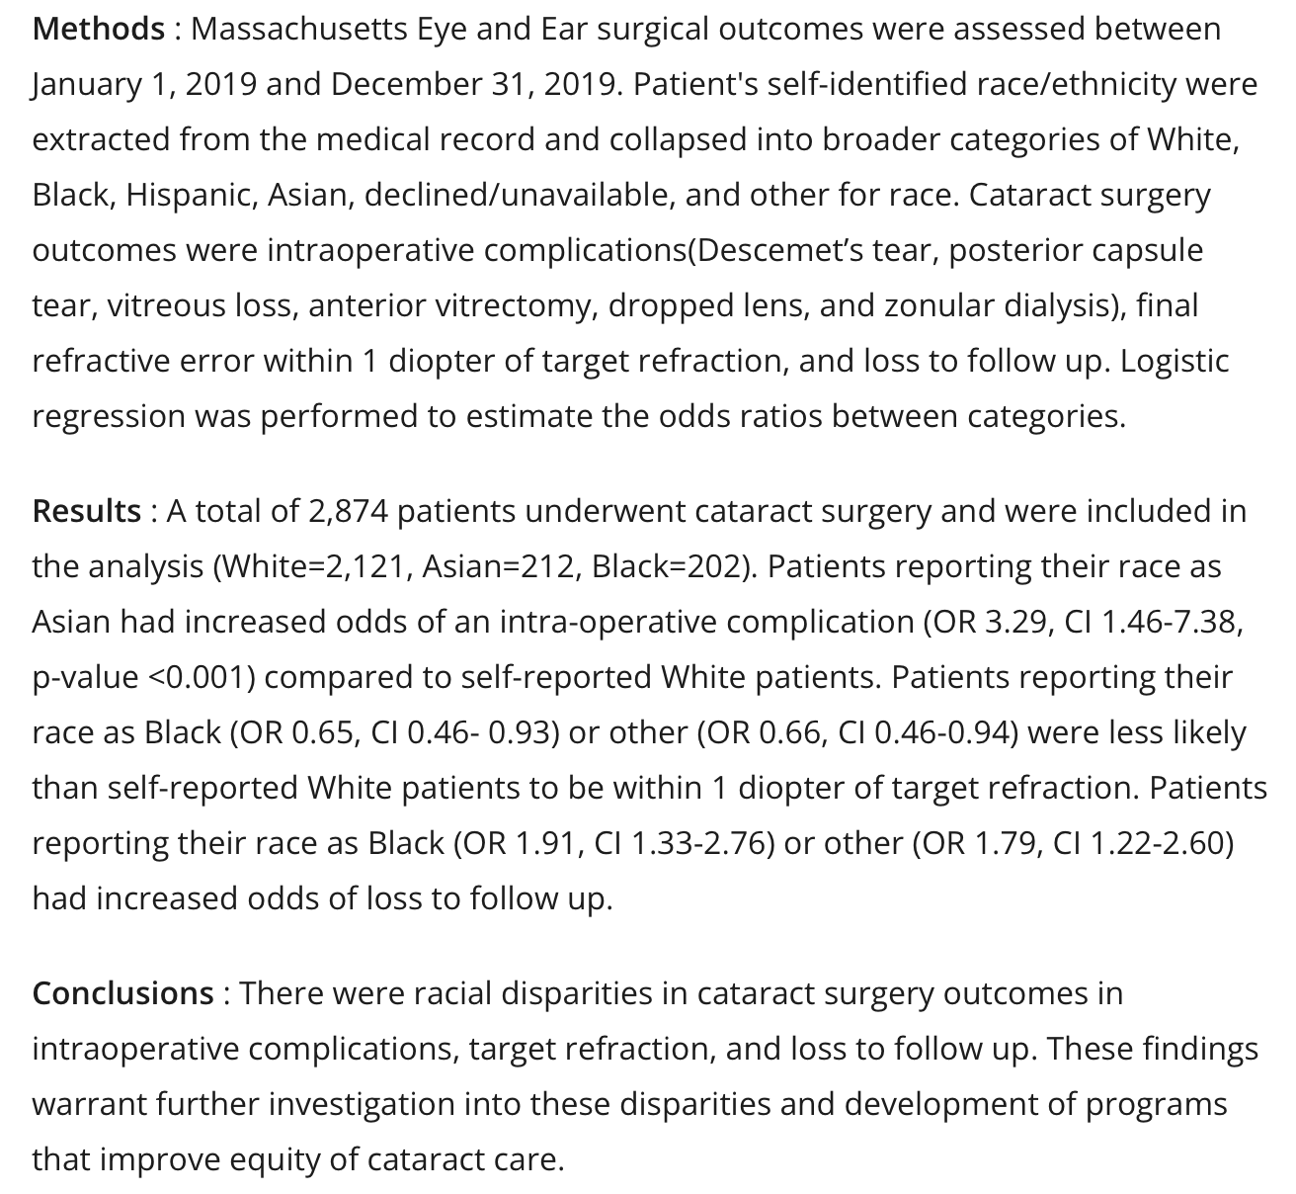

Slide 16
Ophthalmology Tie-In: Endophthalmitis Trends from 2011 -2019

Slide 17
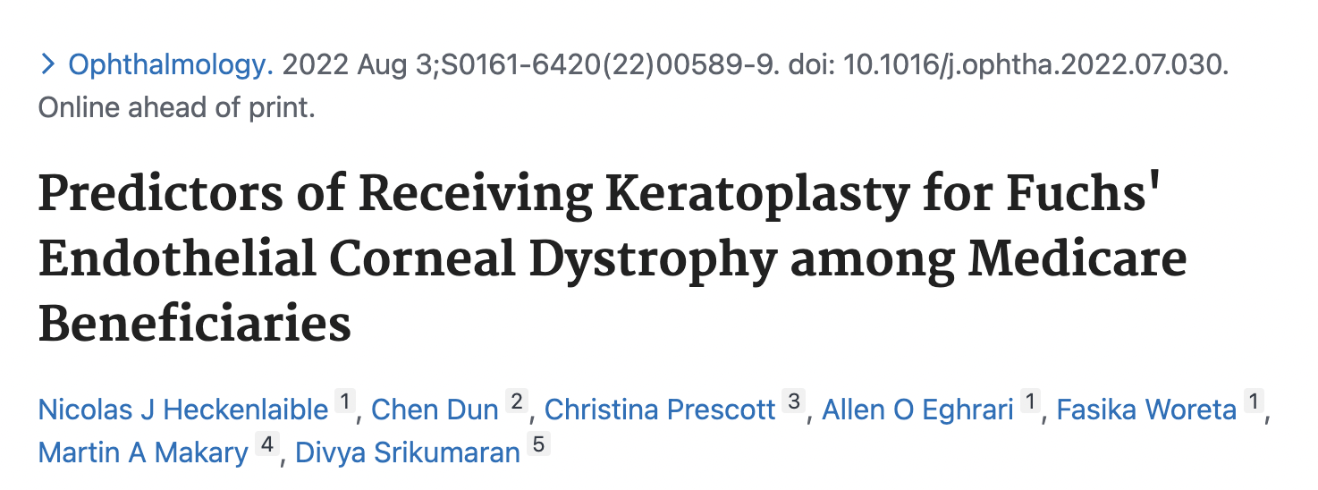
Ophthalmology Tie-In: Keratoplasty

Slide 18
Health Care Access and Quality Priorities for Addressing this Domain
Insurance coverage expansion
Improving preventive health care
Improving communication between physicians and patients
Unconscious bias training and cultural competency training
Providing patient education material in various languages and at an appropriate education level
Offering telehealth to improve services and expand access
Providing vision services in community health centers and vision outreach in underserved areas
Optimizing the electronic health record for screening and patient communication – adding SDOH element to health record
*** At our level, what can we do/what have we done/what can be improved?
* What about increasing diversity in ophthalmology?

Slide 19
2. Economic Stability
One of the most important SDOH, as it affects all other domains
Multiple studies have found associations between low income and unemployment and increased risk of visual impairment, blindness, and sudden vision loss.
Children whose family incomes fall below the federal poverty level are twice as likely to have visual impairment as children whose family income is >200% of the poverty level.
Without stable employment:
Health insurance? Food insecurity? Housing instability?
Access to transportation? Medications and co-pays?

Slide 20
Addressing Economic Stability SDOH Programs that help people achieve economic stability through employment programs, career counseling, and childcare options are needed. ***This is beyond our scope… But what can you do in clinic to address this? Parking and transportation vouchers? Social work consult? Making a consolidated list of community resources and organizations available to your patients? Pharmacy programs for more cost-effective meds?

Slide 21
3. Education Access and Quality
Higher education is strongly associated with improved health outcomes and increased life expectancy.
Early childhood and secondary education are key determinants of future health.
Poor health literacy is associated with increased visual impairment, poor medical adherence, decreased utilization of preventive services, and increased mortality. . .
***What can you do to address this in clinic? When educational material is given to patients, think about health literacy level and tailor accordingly.

Slide 22
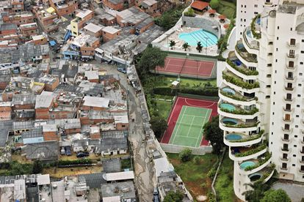
4. Neighborhood and Built Environment
The neighborhood and built environment in which individuals live, learn, work, and play have a direct impact on health and well-being.
In one study, severe vision loss varied significantly by county and was strongly associated with area poverty levels.
How can this affect your patients?
https://english.elpais.com/usa/2022-01-26/nearly-20-years-on-since-famous-snapshot-of-inequality-in-brazil-little-has-changed.html

Slide 23
4. Neighborhood and Built Environment
High rates of crime and violence; unsafe air or water; poor walkability; and limited access to healthful food options, parks, playgrounds, healthy work environments, or transportation negatively affect health outcomes.
The Area Deprivation Index (ADI) is a metric derived from 17 US census variables—including education, employment, income, household characteristics, and housing—to assess the level of socioeconomic disadvantage by neighborhood.

Slide 24
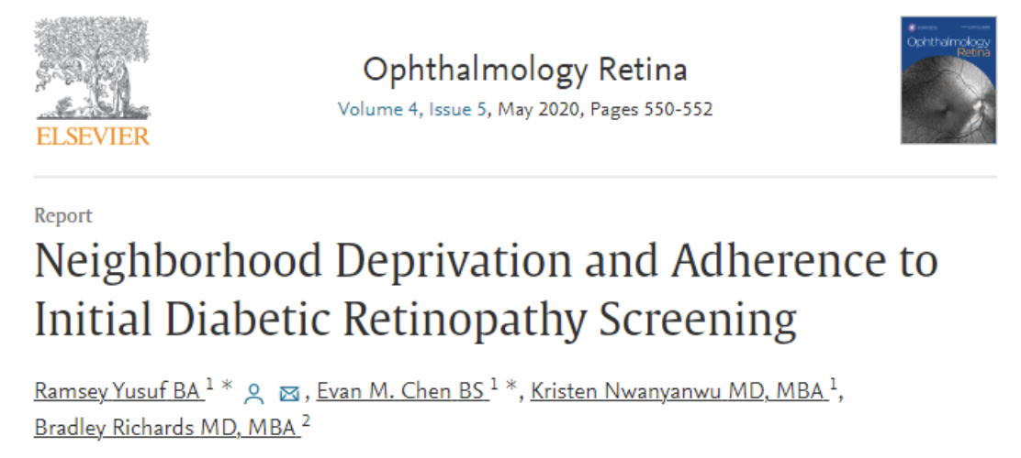
Ophthalmology Tie-in
Living in more disadvantaged neighborhoods, as measured by the ADI, is associated with nonadherence to first-time ophthalmology referrals for diabetic retinopathy screenings.

Slide 25
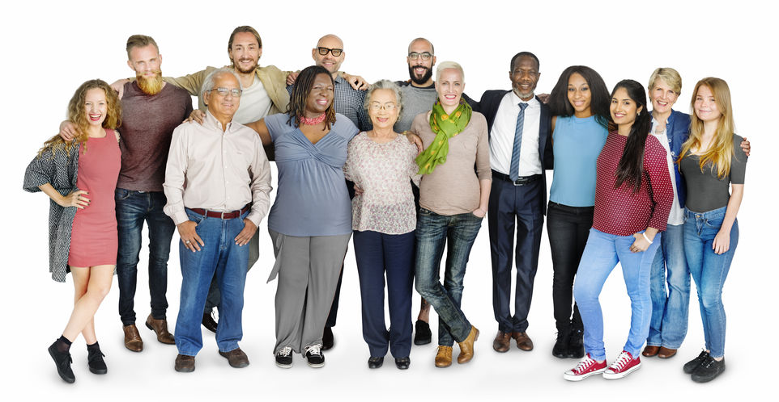
5. Social and Community Context
Social, family, and community networks serve as important support systems for individuals and can significantly affect health outcomes.
Civic participation, social cohesion, and community engagement have positive health effects by reducing stress.
Community engagement by health care providers may improve patient-provider relationships and build trust among patients.

Slide 26
5. Social and Community Context
When patients and physicians are of the same ethnicity, patients report greater satisfaction with their treatment and improved communication – and greater adherence to treatment recommendations.
Although recent US census data show that underrepresented groups make up 30.7% of the US population, only 6% of practicing ophthalmologists are from these groups. . .
Increasing the diversity of the ophthalmologic workforce may help improve patient outcomes for underserved populations.

Slide 27
Diverse physicians are more likely to care for minoritized, medically indigent, and sicker patients.

Slide 28
Discrimination and Social Determinants of Health
Discrimination, a socially structured action resulting in the unfair treatment of individuals or groups based on their ethnicity, gender, sexual orientation, age, disability, religion, or other factors.
Discrimination and unconscious bias significantly affect the health of different population groups.
Do the daily work to dismantle your own biases.

Slide 29
TED Talk: Melanie Funchess
https://youtu.be/Fr8G7MtRNlk?si=RgDzLIb98NEzPPf4

Slide 30
Approaches to Address Social Determinants of Health
Ophthalmologists can play an important role in addressing SDOH in vulnerable patient populations... What can YOU and YOUR team do?
1. Assess the impact of SDOH in patients’ lives as part of every patient encounter.
Similar to HPI etc. – we should assess the role of SDOH in the lives of our patients, how SDOH might affect patient health, and how health care can more effectively be provided?
The screening tool by the American Academy of Family Physicians can be adapted to your clinic.

Slide 31
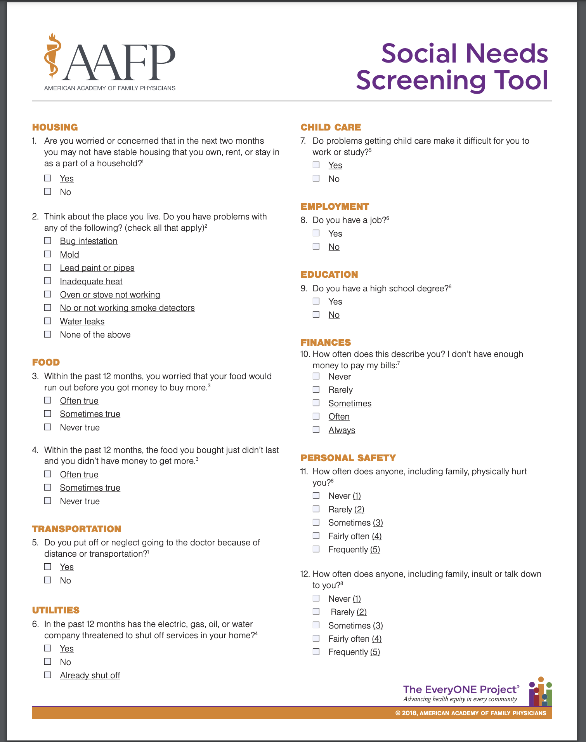

Slide 32
Approaches to Address Social Determinants of Health, cont.
2. Address biases in your practice. How are people of a lower socioeconomic status or lower education or literacy level viewed? By acknowledging potential bias, ophthalmologists can work to mitigate the effects it may have on patient care.
Consider taking an Implicit Association Test to illuminate your own unconscious bias – implement ongoing trainings, not just one!

Slide 33
Approaches to Address Social Determinants of Health, cont.
3. Provide patient-centered care based on the principles of empathy, curiosity, and respect. Consider the patient’s culture and the possible roles of communication styles; mistrust and prejudice; family dynamics and decision making; traditions, customs, and spirituality; and sexual orientation and gender issues.

Slide 34
Approaches to Address Social Determinants of Health, cont.
4. Integrate patient social support structures into your practice. Empower other members of your team to identify and address SDOH. Provide support such as parking or transportation vouchers, low-vision referral, and social work consult.

Slide 35
Approaches to Address Social Determinants of Health, cont.
5. Improve access to care and quality of care. This includes strategies such as improving patient-physician communication and patient health literacy and reducing cultural and linguistic barriers. It may be helpful to do a quality assurance assessment of your practice to identify any disparities in the care being provided to patients.

Slide 36
Interactive Case Scenario
Read the case together.
Pause to think.
Answer reflection questions together.

Slide 37
Robert Swan, MD
SDOH Scenario
A 14-year-old boy from Turkey arrives in the eye clinic with his father to establish care. They both have limited English proficiency (LEP) and speak Arabic in the home. Their primary means of transportation is walking to and from visits.
On examination, the patient has giant papillary conjunctivitis, diffuse scarring of the anterior corneal stroma, and severe posterior subcapsular cataract. Serologic evaluation shows an IgE > 9000. Most of his medications have instructions written in Arabic. He has taken oral methylprednisolone for years. He received extensive medical care in Turkey, and the family brings 70 pages of medical records, all in Turkish. Several medications are prescribed to the nearby university pharmacy rather than their current pharmacy, which is farther away. The patient and father thank you but would prefer to receive medicine at their current pharmacy, even though it is farther away, because it has a pharmacist fluent in Arabic, which allows for Arabic instructions on medication bottles.
Given the complexity of the case, the ophthalmologist and the social worker work together to assign this patient a case worker. The case worker sets up transportation to medical appointments to the allergist, endocrinologist, and eye clinic. Fortunately, this case worker is also fluent in Arabic. When present, the case worker serves as an in-person translator. When not present, video translation is utilized. The English discharge medication list is placed into Google Translate so that an Arabic equivalent can be generated. Both are placed in the discharge instructions. The patient brings all medications at each visit. There is a “Yes” bag of medicines that are on the list and a “No” bag of medicines that are not on the list. Medication reconciliation is done at each visit.
To translate the records, the eye clinic turned to a pediatrician who focused on refugee health care and helped identify the institutional point person for record translation. The records indicated several amniotic membrane grafts had been performed for persistent epithelial defects along with excision and steroid injections of the conjunctival papillae. It turns out that the Turkish ophthalmologists had referred the patient to pediatric endocrinology to taper the steroids, but because of the frequent moves, the medication had continued at the initial dose. With the combination of help with transportation, translated records, a pharmacist and case worker who speak Arabic, and an accessible discharge medication list, the patient has done very well.

Slide 38
Explanation:
LEP is associated with higher medical costs and lower access to care. Advancing language access as a means of improving health outcomes is part of the Centers for Medicare & Medicaid Framework for Health Equity. https://www.cms.gov/files/document/cms-framework-health-equity-2022.pdf. Residents and attendings may not be aware of the resources available at their institution. This case reflected significant effort and learning by our eye clinic to identify the resources necessary to care for this individual. For more information on this subject, please consider the excellent review: Professional Interpreter Services and the Impact on Hospital Care Outcomes: An Integrative Review of Literature available without charge at: https://www.ncbi.nlm.nih.gov/pmc/articles/PMC10048935/
Reflection Questions:
What social determinants of health are at play in this patient’s care?
What would happen if SDOH were not addressed in this case?
Where would you turn to translate records critical to the care of your patient?
What did you think of the approach to medication reconciliation for this patient? Is it too complicated? Where could a problem arise?
Have you ever considered using an online translation resource for medications or instructions? What are the limitations?

Slide 39
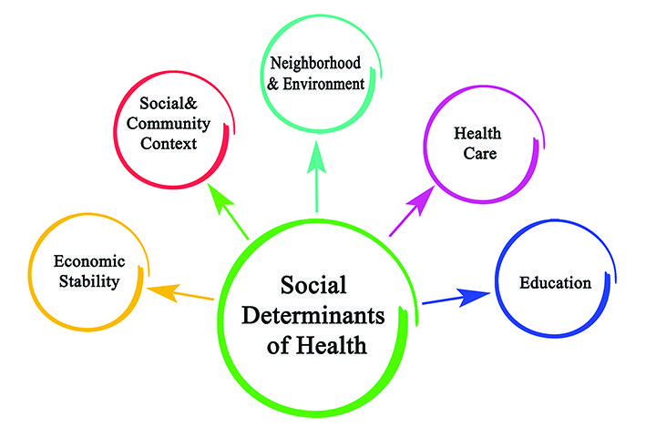
Key Points
Social determinants of health are major drivers of health disparities, including in ophthalmology. You must be aware of them and recognize them in your patient encounters – and you can address them.
5 domains of SDOH
Health care access and quality
Economic stability
Education access and quality
Neighborhood and built environment
Social and community context
Notes:
Health care access and quality (e.g. insurance, physician availability, communication)
Economic stability (e.g. employment, income, housing and food security)
Education access and quality (e.g. education, literacy, language skills)
Neighborhood and built environment (e.g. transportation, safety, geography, pollution, parks)
Social and community context (e.g. community engagement, social cohesion, incarceration rates)

Slide 40
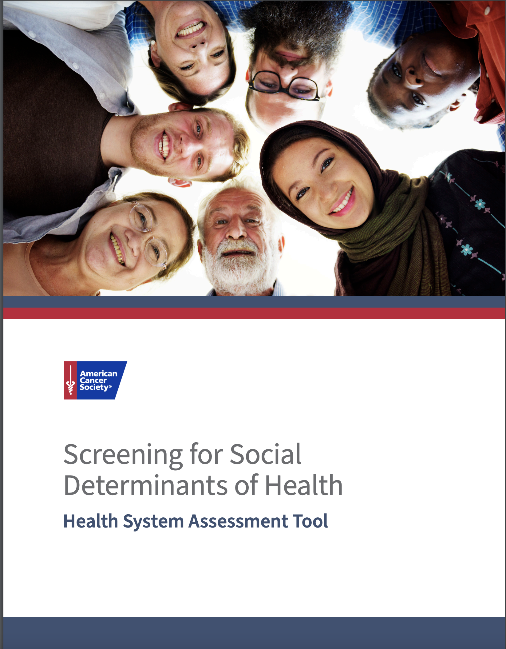
Key Points
We should assess the impact of SDOH as part of every patient encounter and should address SDOH in the treatment of patients.
Ophthalmologists can play an important role in addressing SDOH in vulnerable patient populations.

Slide 41
Post-Quiz
What defines health inequity and health disparity?
Are you able to name a few SDOH? What are the 5 domains of SDOH?
Why do you think they matter?
What are you going to do to address them?

